Slide 1
Seeing the world through Jesus’ tears

Slide 2
“Your kingdom come, your will be done on earth as it is in heaven”
Matthew 6:10
What would heaven on earth look like today?

Slide 3
“ …I have come that they may have life and have it to the full. “John 10:10
”..neither do people light a lamp and put it under a bowl, instead they put it on a stand and it gives light to everyone in the house” Matthew 5:15

Slide 4
Our Father God
”Then the Lord came down in the cloud and stood there with him and proclaimed his name the Lord, and he passed infront of Moses proclaiming the Lord, the Lord, the compassionate and gracious God, slow to anger, abounding in love and faithfulness”
Exodus 34 vs 5
He has shown you O mortal what is good, and what does the Lord require of you? To act justly and to love mercy and to walk humbly with your God.”
Micah 6:8

Slide 5
Jesus
Compassion is different from sympathy….
the difference lies in how we respond to another person’s suffering…
Sympathy- is feeling for someone e.g. recognising that someone is hurting.
Compassion is feeling with someone and taking action.
An example would be imagine someone had fallen into a ditch.
“Suppose a brother or sister is without clothes and daily food. If one of you says to them, Go in peace, keep warm and well fed, but does nothing about their physical needs what good is it…”
James 2: 15-16

Slide 6
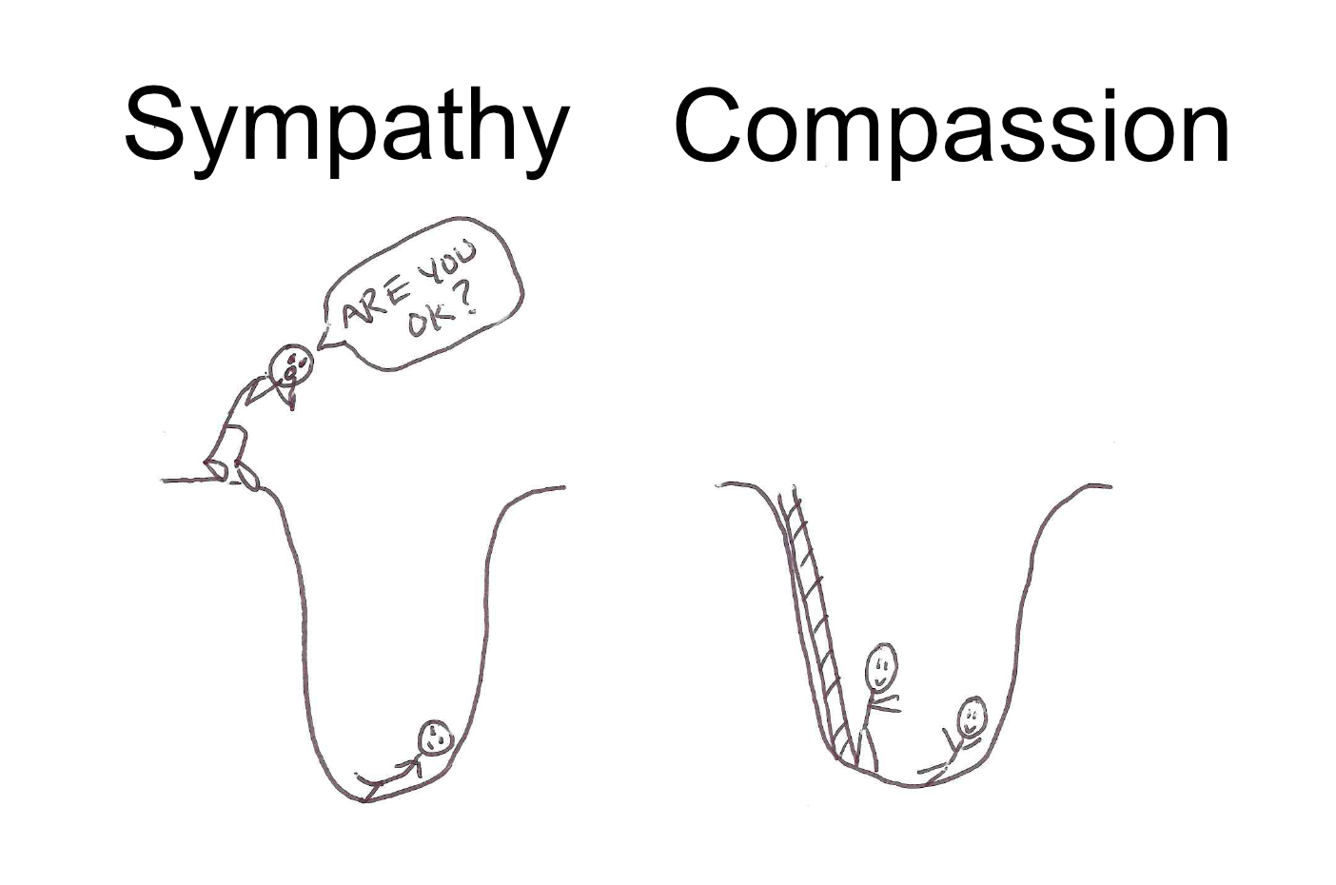

Slide 7
Jesus
Person | World eyes | Jesus’ eyes
Matthew | Sinner, tax collector | Disciple
Zaccheus | Corrupt tax collector | Capable of repentance and change
Woman at the well | Outcast, Samaritan, brought shame on herself | Broken, hurting woman, first account of an evangelist
Leppers | Outcasts, cursed, to be avoided | Needed healing, freedom to live life
Children | Unimportant, low down in hierarchy | Welcomed them, the example of how we should be to enter his kingdom

Slide 8
Sheep and Goat
Matthew 25 vs 31-46
“the King will reply, truly I tell you, whatever you did for the least of these brothers and sisters of mine, you did for me.”
Matthew 26:40

Slide 9
Our response
Barriers:
Inconvenient/Interruption
Conflict of comfort
Hearts grown cold overtime-disillusioned and discouraged

Slide 10
RESPONSE
Soften our hearts
Abiding
Ask Holy Spirit to guide us/lead us

Slide 11
Isaiah 61
“The spirit of the sovereign Lord is on me because the Lord has anointed me to proclaim good news to the poor. He has sent me to bind up the broken hearted, to proclaim freedom for the captives and release from darkness for the prisoners, to proclaim the year of the Lord’s favour and the day of vengeance of our God, to comfort all who mourn”

