Slide 1

I found myself drawing a heart on paper
My thoughts were feeling muddled and cluttered and pulled in all directions
I began to write around this heart all the people, places, things that occupy my thoughts
I think I started with the heart because I was also thinking about Paul’s prayer in Ephesians 1v18
“I pray that the eyes of your heart may be enlightened” (open the eyes of our hearts)
And there’s a saying about “things that pull on our heart strings”
So, I found my drawing helpful, almost like I had emptied my head and with this
visual created a picture to look at
(DRAW ON WHITE BOARD)
When I finished and looked at it there was this heart in the centre and I put eyes on it and
myself at the top. And I then found my focus was on this heart.
What do the eyes of my heart see when I think of these people, places, situations, and things that
pull on my heart strings.
I will rub mine out and let you take a moment to imagine what you would put around yours.
These attachments may carry emotions and you can take a moment to feel those emotions
Now let’s look at the GOOD NEWS
READ EPHESIANS 3

Slide 3
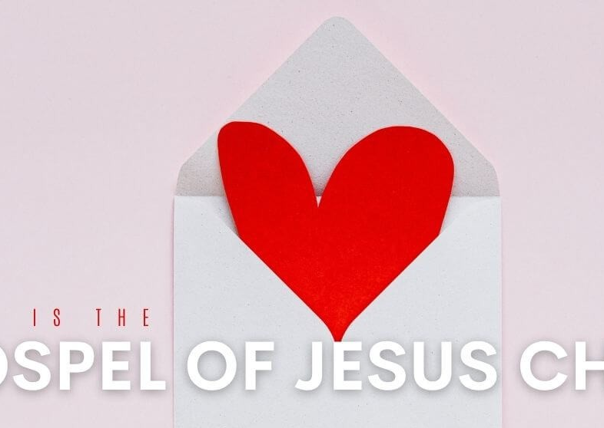
Ephesians 3
Paul shares what the Holy Spirit had shown him
Through the GOSPEL the Gentiles are heirs together with Israel, members together of one body, and SHARERS TOGETHER in the PROMISE OF CHRIST JESUS
GOSPEL: message of salvation
teachings of Jesus
plan to reconcile us to God
overcoming of sin and death
life ,death and resurrection of Jesus
GOSPEL – Euaggelion = GOOD NEWS
JESUS BROUGHT THE REIGN OF GOD TO OUR WORLD THROUGH HIS LIFE, DEATH AND RESURRECTION
HE SHOWED THIS IN HIS ENCOUNTERS WITH THE PEOPLE HE TOUCHED

Slide 4
Paul says it again in Romans 1 v2-5
The GOSPEL he promised beforehand through his prophets
in the Holy scriptures regarding his Son,
who as to his earthly life was a descendant of David,
and who through the Spirit of holiness was appointed
the SON of God IN POWER by his resurrection from the dead,
JESUS CHRIST OUR LORD.
Through him we received grace and apostleship
to call all the Gentiles to the obedience
that comes from faith for his name’s sake.
And you also are among those Gentiles
who are called to BELONG TO JESUS CHRIST.

Slide 5

Jesus said in Mark 1v15
THE KINGDOM OF GOD HAS COME NEAR, REPENT AND BELIEVE THE
GOOD NEWS!!
Isaiah 52v2
How lovely on the mountains are the feet of him who brings GOOD NEWS. Who announces peace and brings GOOD NEWS of happiness. Who announces salvation. And says to Zion
YOUR GOD REIGNS!!

Slide 6
Although I am the less than the least of all God’s people this grace was given to me: to preach to the Gentiles the BOUNDLESS RICHES OF CHRIST, and to make plain to everyone the administration of this mystery, which for ages past was kept hidden in God, who created all things.
Administration - koinonia = fellowship, participation, partnership, social intercourse, communicate
His intent was that now, through the church, the manifold wisdom of God should be made known to the rulers and authorities in the heavenly realms, according to his eternal purpose that he ACCOMPLISHED IN CHRIST JESUS OUR LORD.
In him and through faith in him we may approach God with freedom and confidence.
THIS IS GOOD NEWS!!

Slide 7

Now I can approach all these relationships, situations, places things that pull on my heart strings with confidence.
From the place in my heart where Jesus lives
I am not alone
I can bring them to the Father
I can ask him how to pray. He promises the power of the Holy Spirit.
Anna reminded us: Faith filled prayers not worrying prayer
Ephesians 6: Paul encourages us to put on the breast plate of righteousness. (Breastplate shields my heart)
We don’t war against flesh and blood
Hebrews 1v9: We, like Jesus, can love righteousness and hate wickedness (will we be anointed with the oil of joy?)
Ephesians 3v10: Can we be reflectors of God’s manifold wisdom and over come the things that war against us.
Is this the promise of the GOOD NEWS, the GOSPEL
Paul’s prayer is………..
God is able…….(immeasurably more!!)
His love is wider, deeper, higher, greater than ours.
THIS IS GOOD NEWS!! Can we grasp it!!

