Slide 1
Open our eyes to see
The spiritual battle around us
Living victoriously
free from the power of the world the flesh
and the devil

Slide 2
Our struggle is not against flesh and blood, but against the rulers, against the authorities, against the powers of this dark world and against the spiritual forces of evil in the heavenly realms. Eph 6: 12
For though we live in the world, we do not wage war as the world does. The weapons we fight with are not the weapons of the world. On the contrary, they have divine power to demolish strongholds. 2 Corinthians 10: 3-4
Be alert and of sober mind. Your enemy the devil prowls around like a roaring lion looking for someone to devour. 1 Peter 5 v 8
The thief comes only to steal and kill and destroy; I have come that they may have life, and have it to the full. John 10:10
lead us not in to temptation but deliver us from the evil one Matthew 6:13
My prayer is not that you take them out of the world but that you protect them from the evil one. John 17 v 15

Slide 3
If God is for us, who can be against us? Romans 8: 31
Who shall separate us from the love of Christ? Shall trouble or hardship or persecution or famine or nakedness or danger or sword? Romans 8: 35
For I am convinced that neither death nor life, neither angels nor demons, neither the present nor the future, nor any powers, neither height nor depth, nor anything else in all creation, will be able to separate us from the love of God that is in Christ Jesus our Lord. Romans 8: 38-39

Slide 4
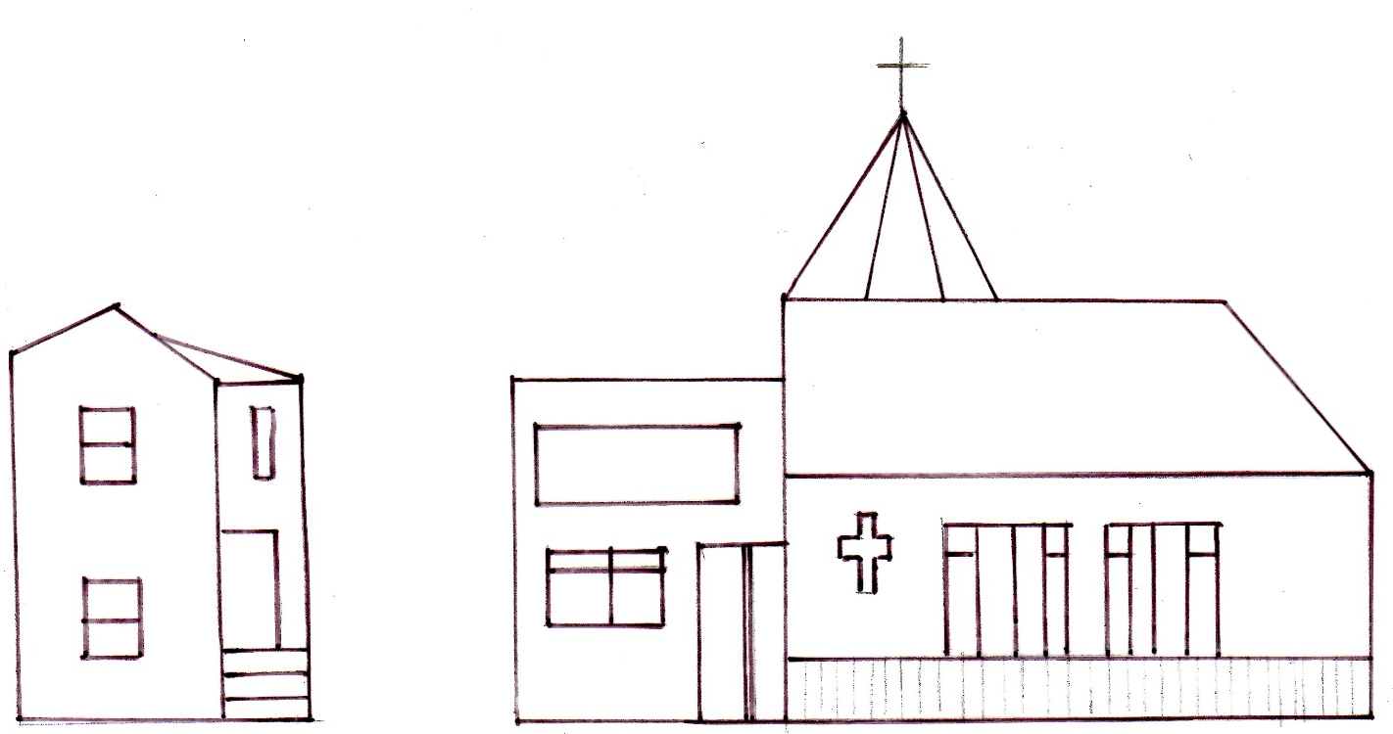


Slide 5
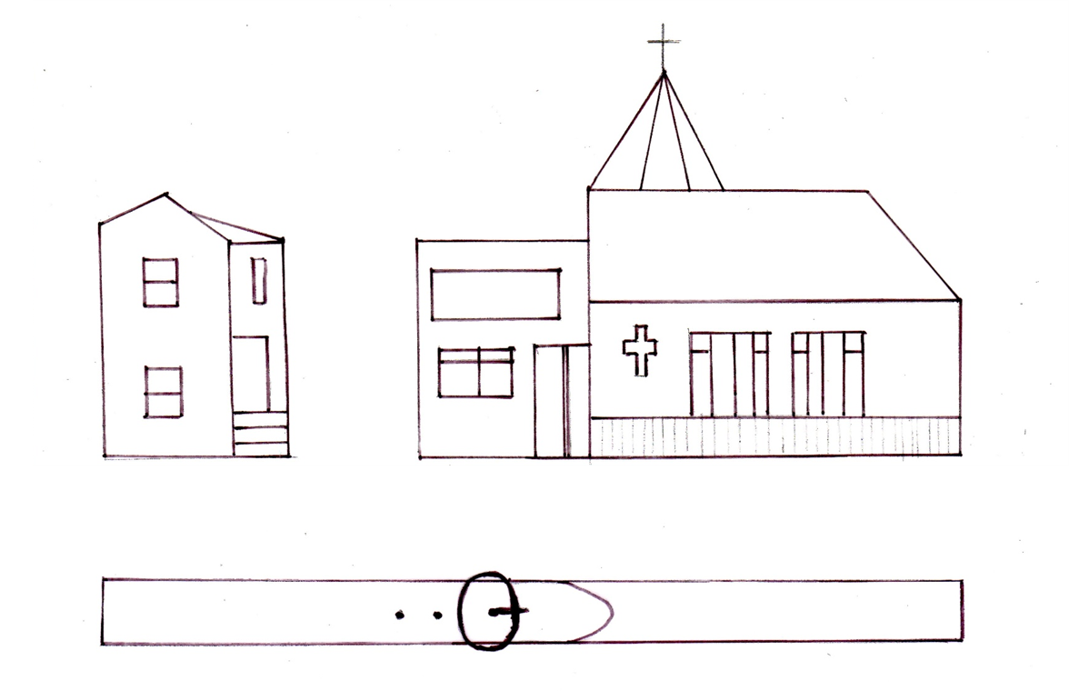

Slide 6
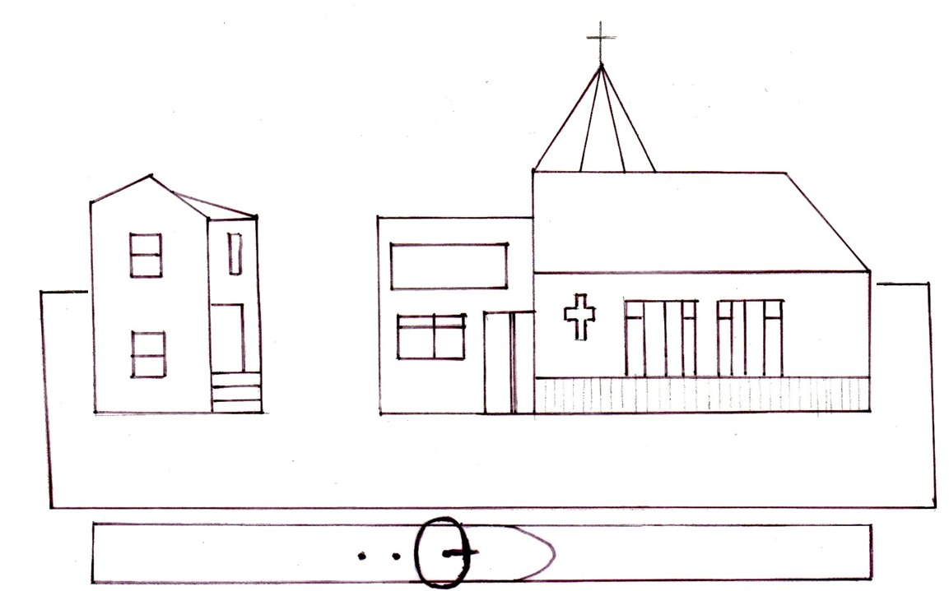

Slide 7
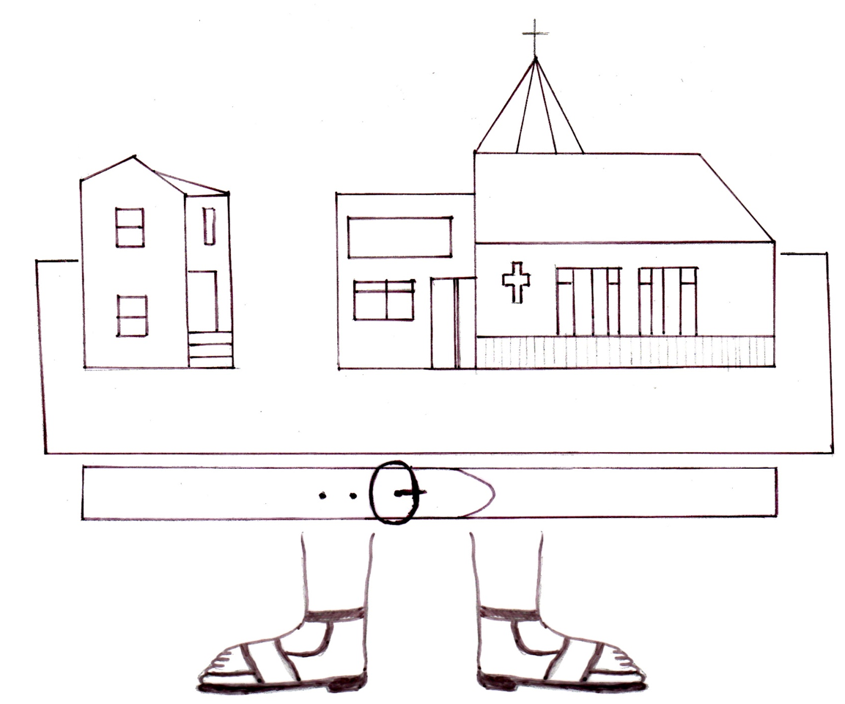

Slide 8
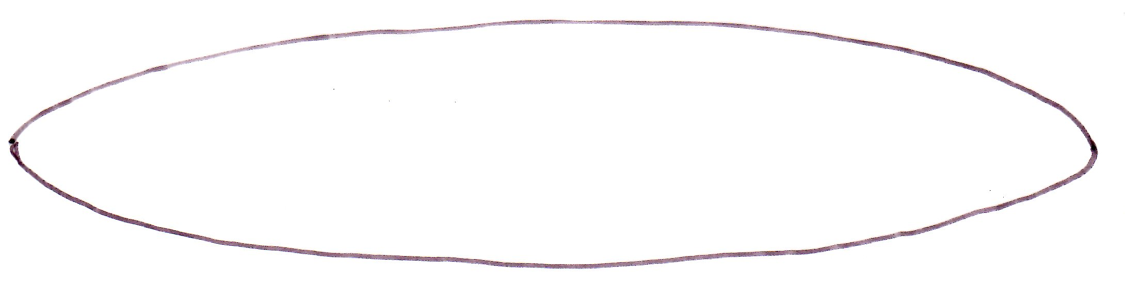

Slide 9
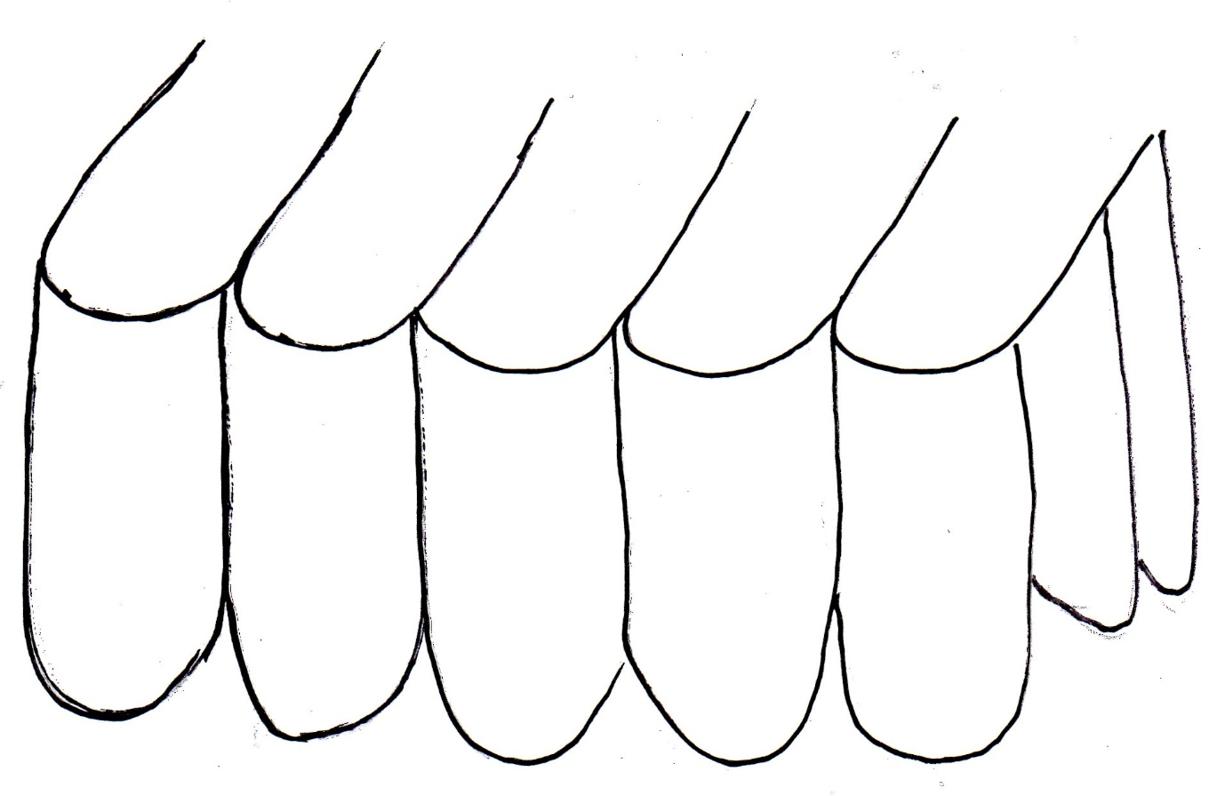

Slide 10
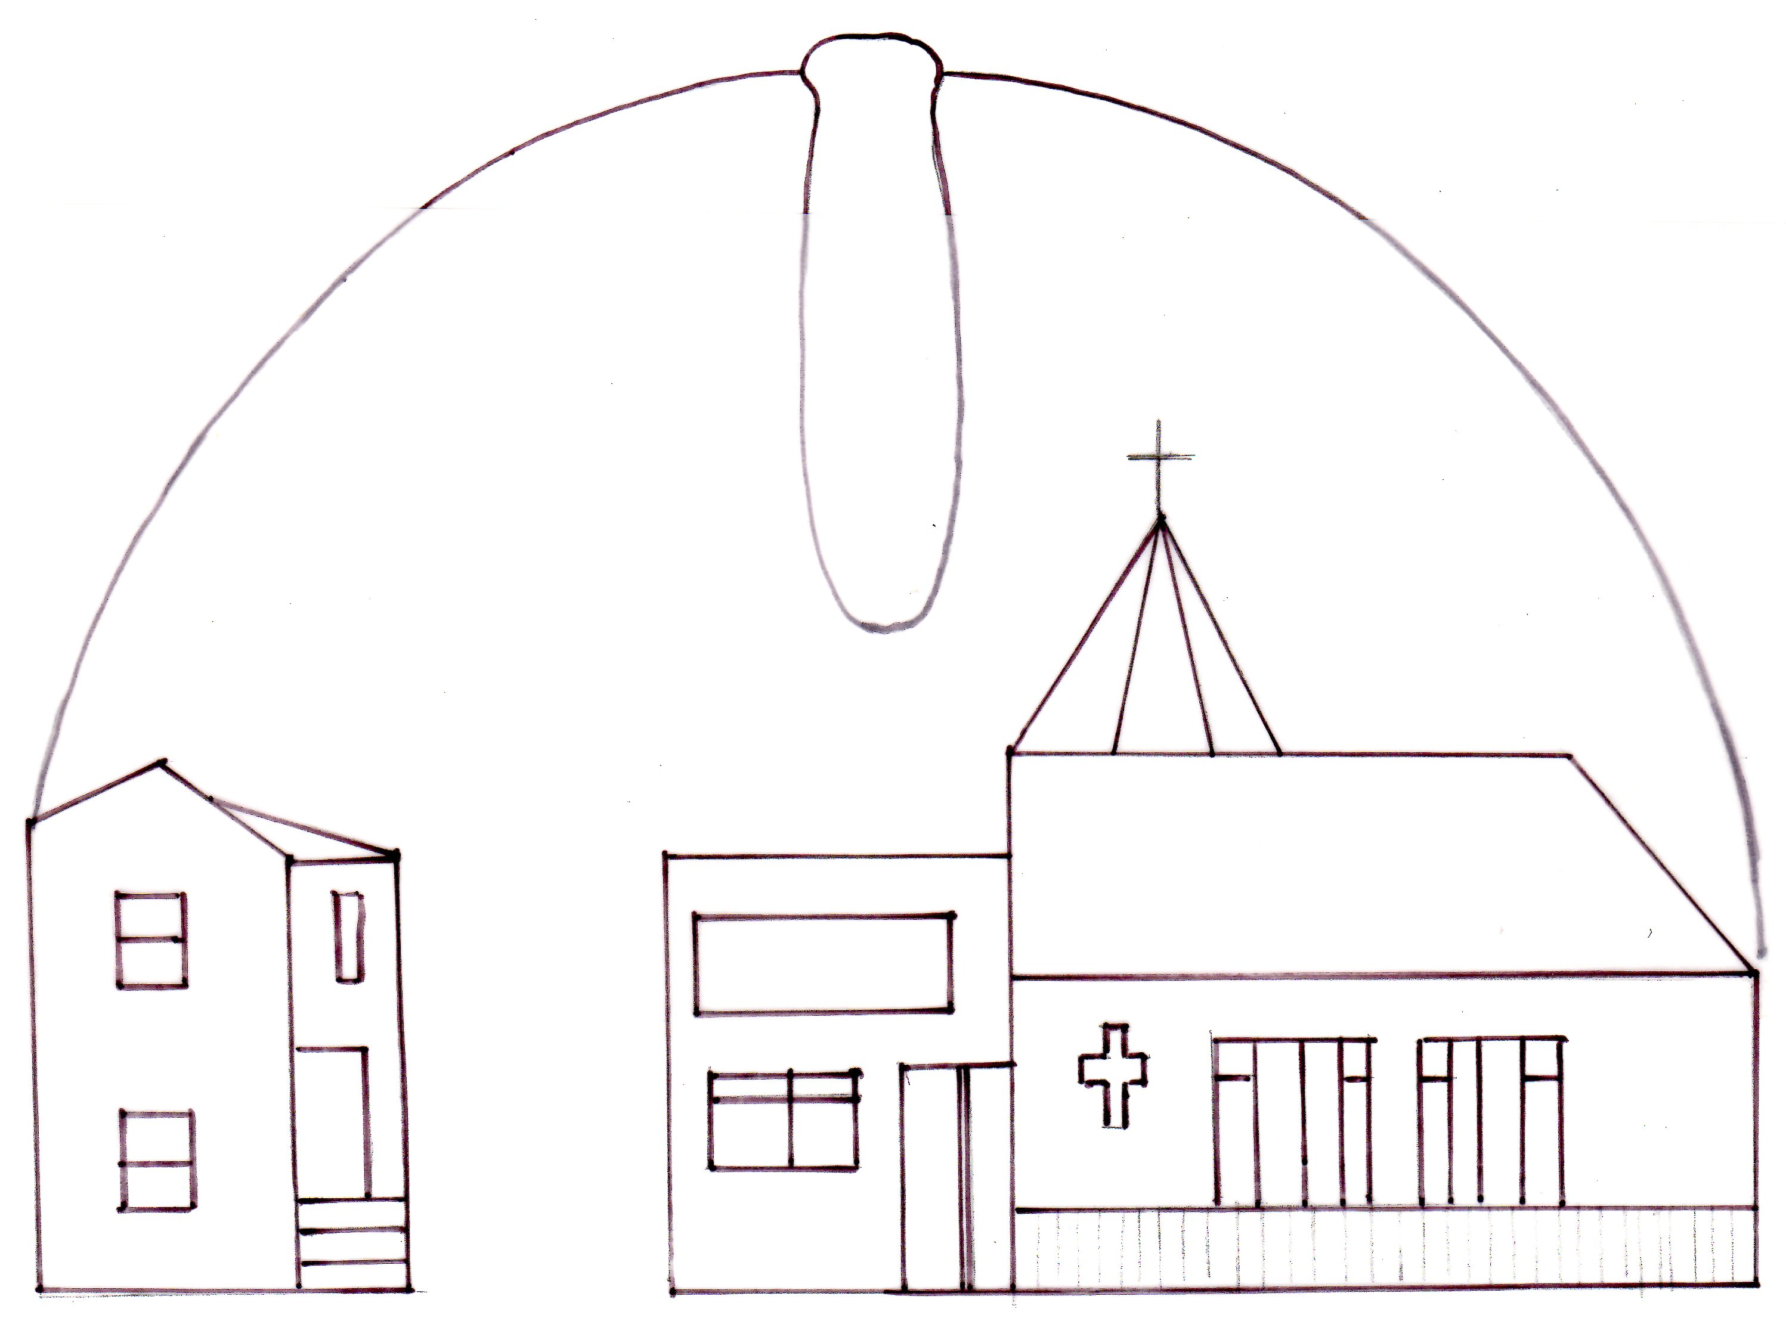
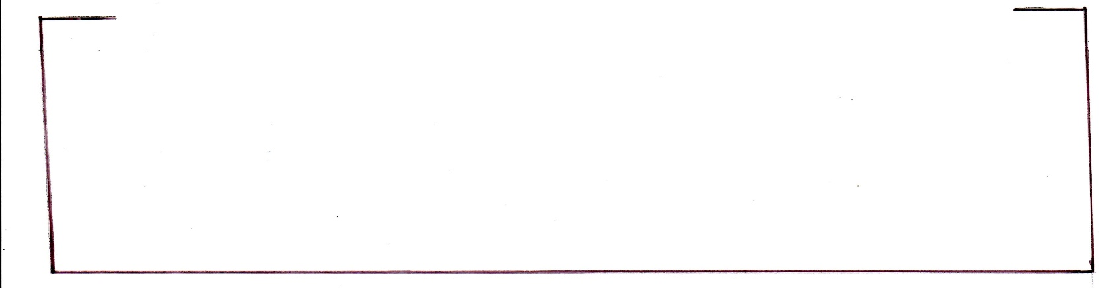

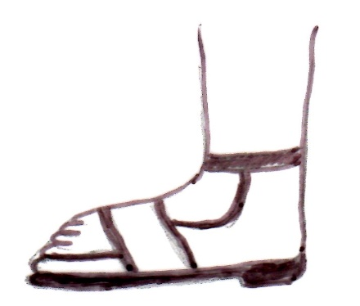

Slide 11
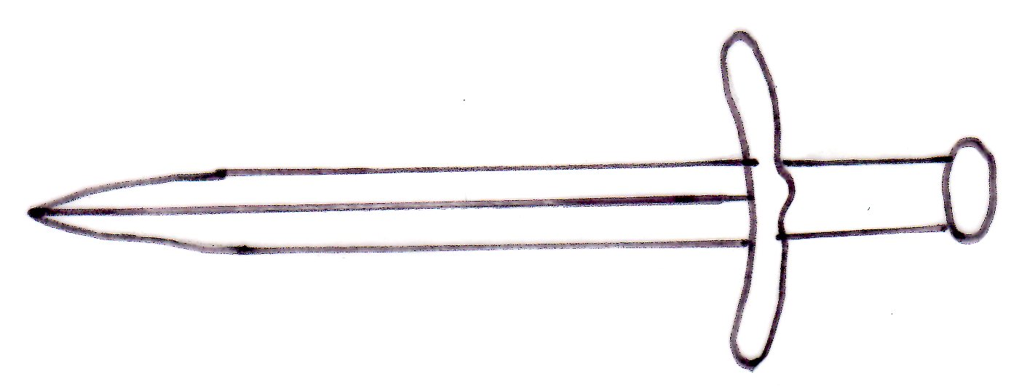

Slide 12
