Slide 1
Open our eyes to see the Power of Prayer
(Heart Posture)

Slide 2
Confess to one another therefore your faults (your slips, your false steps, your offenses, your sins) and pray [also] for one another, that you may be healed and restored [to a spiritual tone of mind and heart].
The earnest (heartfelt, continued) prayer of a righteous man makes tremendous power available [dynamic in its working].
James 5: 16 AMPC

Slide 3
Confess your trespasses to one another, and pray for one another, that you may be healed.
The effective, fervent prayer of a righteous man avails much.
James 5: 16 NKJV

Slide 4
To produce power, prayer needs to be:
Fervent: heartfelt, full of passion and zeal, sincere & truthful
Jer 29: 12-13
2 Chron 15: 12 -15
Effectual: alive and working, energized from within by the power of the Spirit; aligned with God’s will
1 John 5: 14-15
Matt 6:10

Slide 5
How to pray the will of God
Pray with Scriptures – prayer requires a scriptural basis
1 John 5:14–15
Pray in the Spirit – only He can reveal the heart of God
Rom 8:26–27

Slide 6
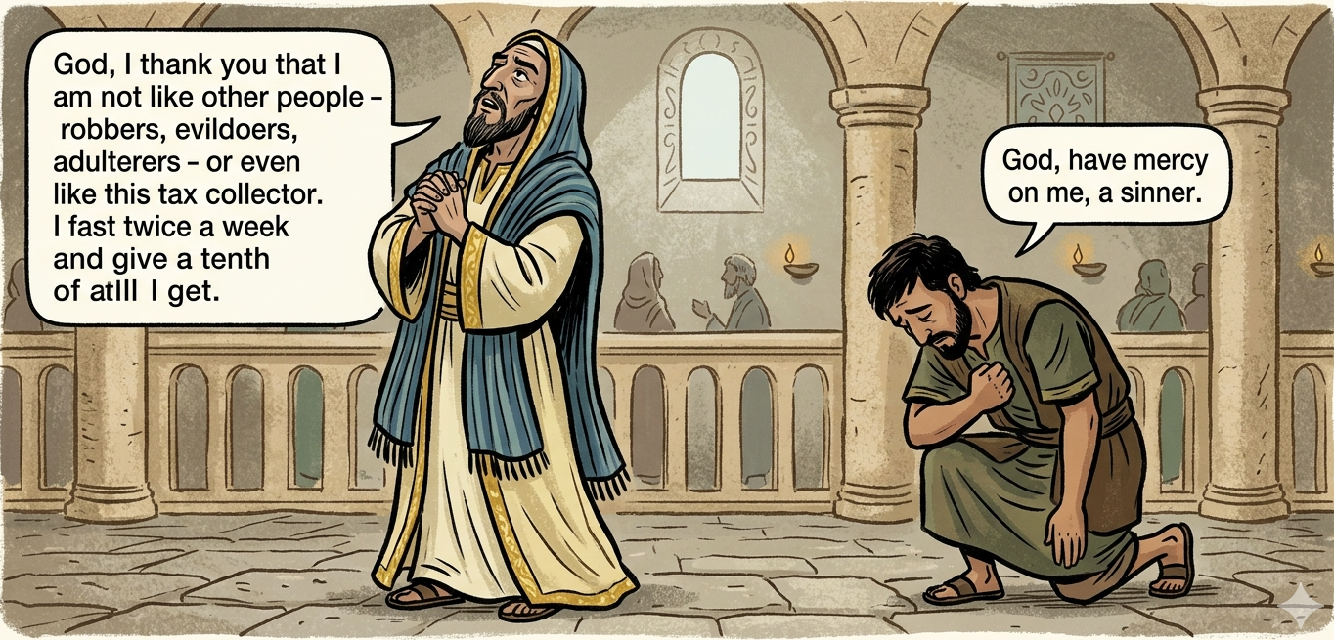
The posture of our heart affects our prayers
Luke 18: 9-14

Slide 7
Heart postures that empower prayers
Thanksgiving – Psalm 100: 4-5
Worship – Psalm 34: 1-2
Repentance – Psalm 51: 10
Purity – Psalm 24: 4-5

Slide 8
Heart postures that empower prayers
Humility – 2 Chron 7:14
Thirst – Psalm 63: 1-2
Faith – Matt 21: 22
Waiting – Psalm 40:1
Persistence – Luke 11:9-10; 18:1

Slide 9
Heart postures that hinder prayers
Self-righteousness – Luke 18: 9-14
Discord – 1 Peter 3:7
Unforgiveness – Mark 11: 25-26
Sin – Psalm 66:18

Slide 10
The highest form of prayer comes from a humble heart

Slide 11
FEAR
But now, thus says the Lord, who created you, O Jacob And He who formed you, O Israel: “Fear not, for I have redeemed you; I have called you by your name; You are Mine. When you pass through the waters, I will be with you; and through the rivers, they shall not overflow you. When you walk through the fire, you shall not be burned, nor shall the flame scorch you. For I am the Lord your God, the Holy One of Israel, your Savior; I gave Egypt for your ransom, Ethiopia and Seba in your place.
Isaiah 43: 1-3

Slide 12
CHILDREN
All your children shall be taught by the Lord, and great shall be the peace of your children. Isaiah 54:13

Slide 13
FRESH ANOINTING
But my horn (emblem of excessive strength and stately grace) You have exalted like that of a wild ox;
I am anointed with fresh oil. Psalm 92:10

Slide 14
BLESSING
“Do not remember the former things, nor consider the things of old.
Behold, I will do a new thing, now it shall spring forth;
Shall you not know it?
I will even make a road in the wilderness and rivers in the desert.” Isaiah 43: 18-19

Slide 15
PROTECTION
I lift up my eyes to the mountains - where does my help come from?
The Lord will keep you from all harm - He will watch over your life
Psalm 121: 1,7

Slide 16
HEALING (HEART & BODY)
Beloved, I pray that you may prosper in all things and be in health, just as your soul prospers.
He heals the brokenhearted and binds up their wounds.
3 John 1:2, Psalm 147:3

